Slide 1
OpenChain Project
Update for OpenChain Japan Community Day #34 – 2025-07-31

Slide 2
Our standards are the international baseline for quality in open source license compliance and security assurance programs. Our guides and reference material helps people solve compliance challenges. Our community provides a space to share knowledge.

Slide 3
Our News

Slide 4














1H 2025 Overview
New Platinum Member:
ISO/IEC 5230 Co-Announcements:
Recertification Co-Announcements:
ISO/IEC 18974 Co-Announcements:
Proposed updates to ISO/IEC 5230 and ISO/IEC 18974 finished public comments and freeze periods, moved to Steering Committee.
Maturity models released.
“Explainers” for company departments released.
Open source policy template updated. Telco SBOM Quality Guide updated.
AI BOM Compliance Guide complete, board approval pending.
Cross-industry SBOM quality guide early drafting.
Reorganized reference library of 1,500~ resources. Better discoverability of processes
Improved integration with other LF Project activities (e.g. OpenSSF).

Slide 5


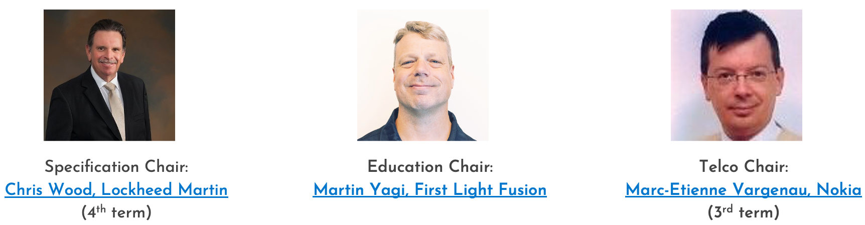


July 2025
ISO/IEC 5230 Conformance Announcements:
(reconformance)
Public Comment Period Announced: Artificial Intelligence System Bill of Materials – Compliance Management Guide for the Supply Chain
Newly elected 2025/2026 chairs for the Specification, Education and Telco Work Groups
Community Publications: OpenChain Tooling Work Group – The 2025 Video Series Korean Translation of the OpenChain Telco SBOM Guide Handbook for Software Supply Chain Security in the Telco Industry
Spec and Education: NA / EU + EU / Asia Calls
AI Work Group: NA / EU + EU / Asia Calls
SBOM Work Group: Monthly Call
Webinars: Project OCCTET.eu – The Why, What and How How we are doing compliance at CARIAD with ORT Case Study on ZF’s ISO/IEC 5230 Third-Party Certification
Germany Work Group: 2H 2025 Strategy Call
India Work Group: 2H 2025 Strategy Call
Recording: OpenChain Mini-Summit @ OSS NA

Slide 6
What’s Next?

Slide 7
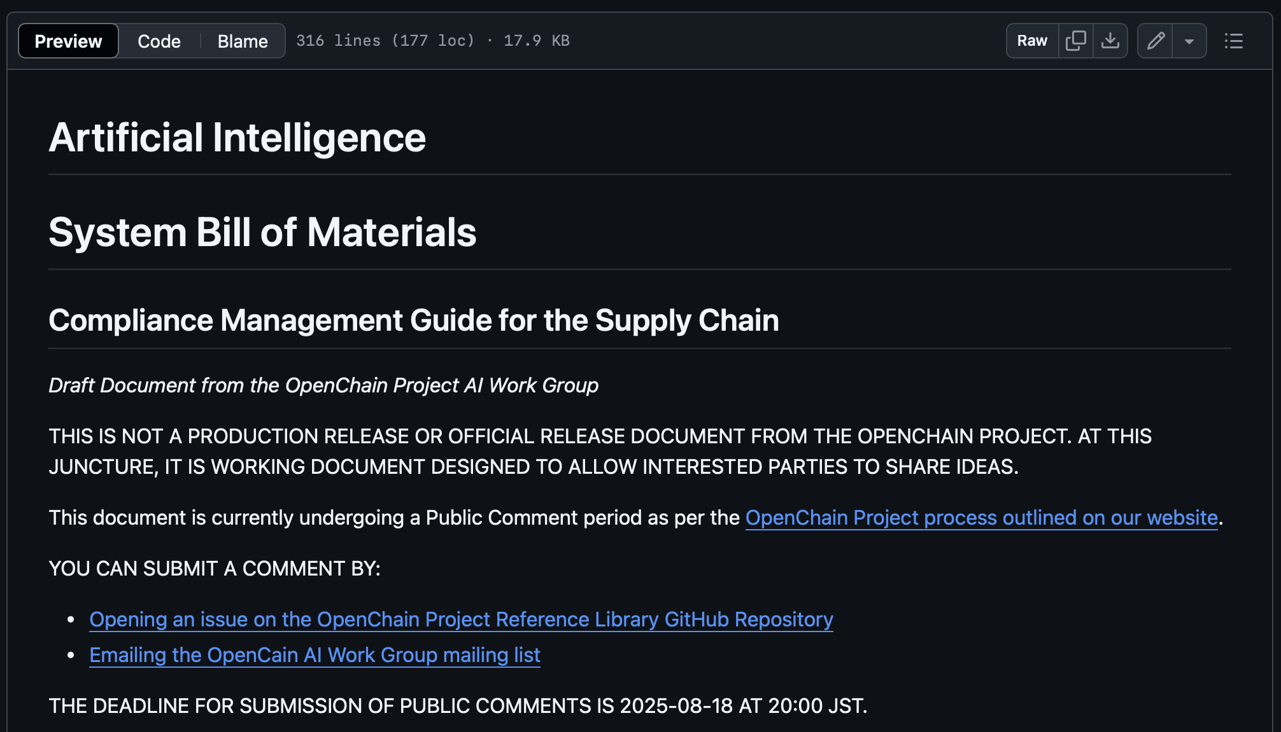
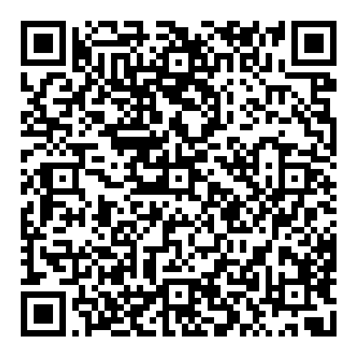
AI BOM Compliance in the Supply Chain Guide

Slide 8
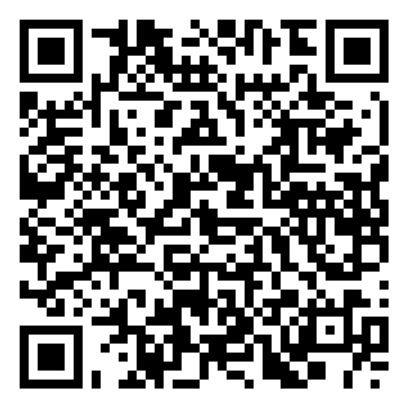
Cross-Industry SBOM Quality Guide Concept

Slide 9
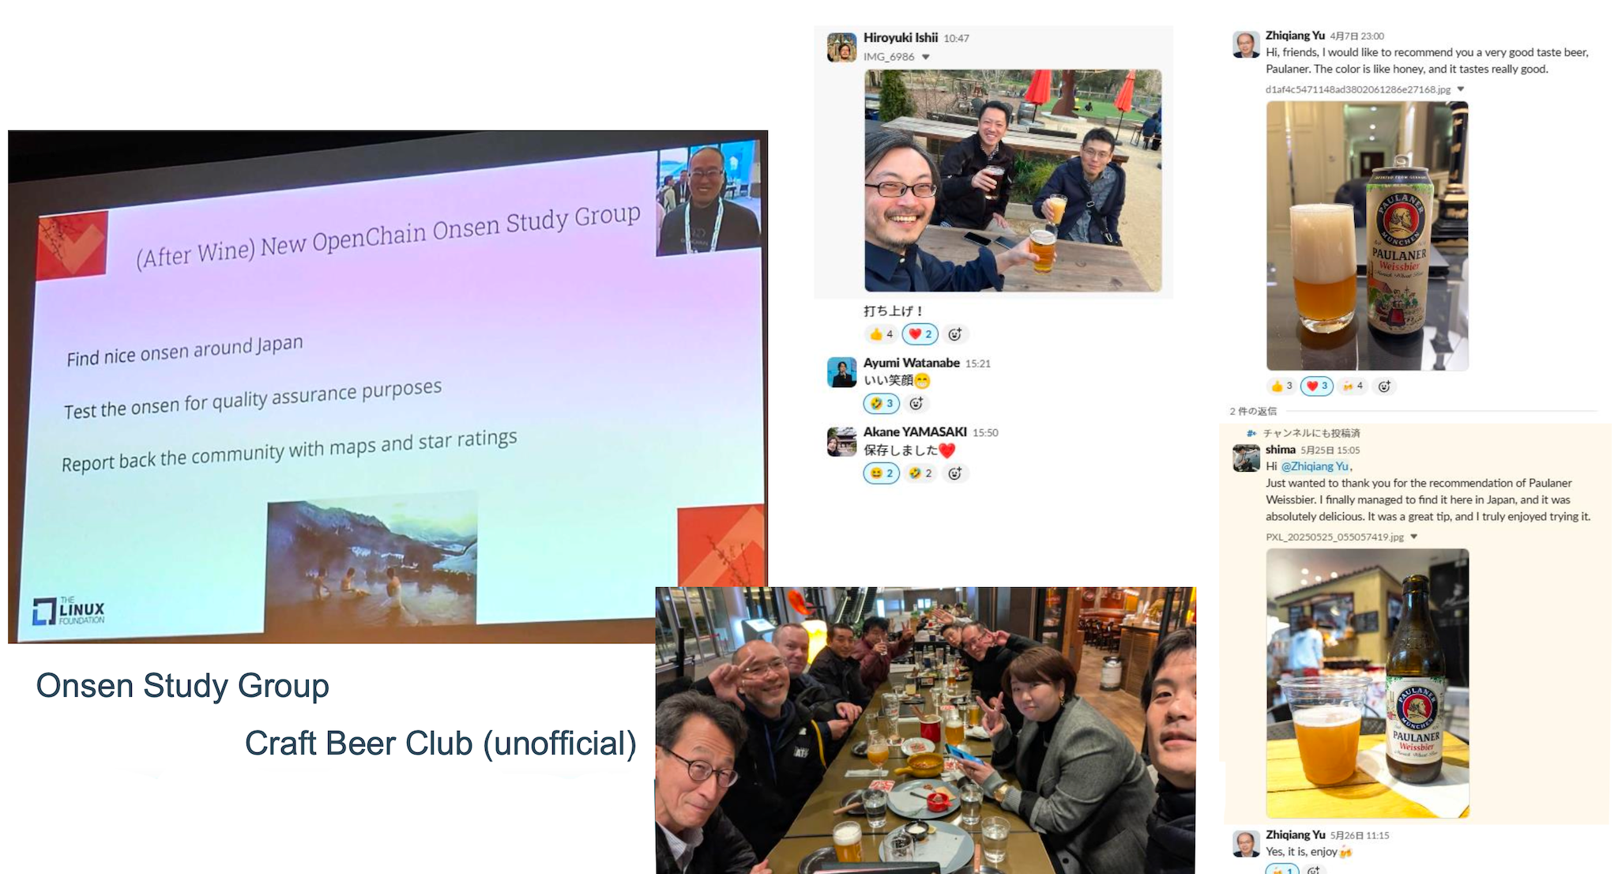
Our Message: You Are Always Welcome!
New in Korea: Makkoli Study Group

Slide 10
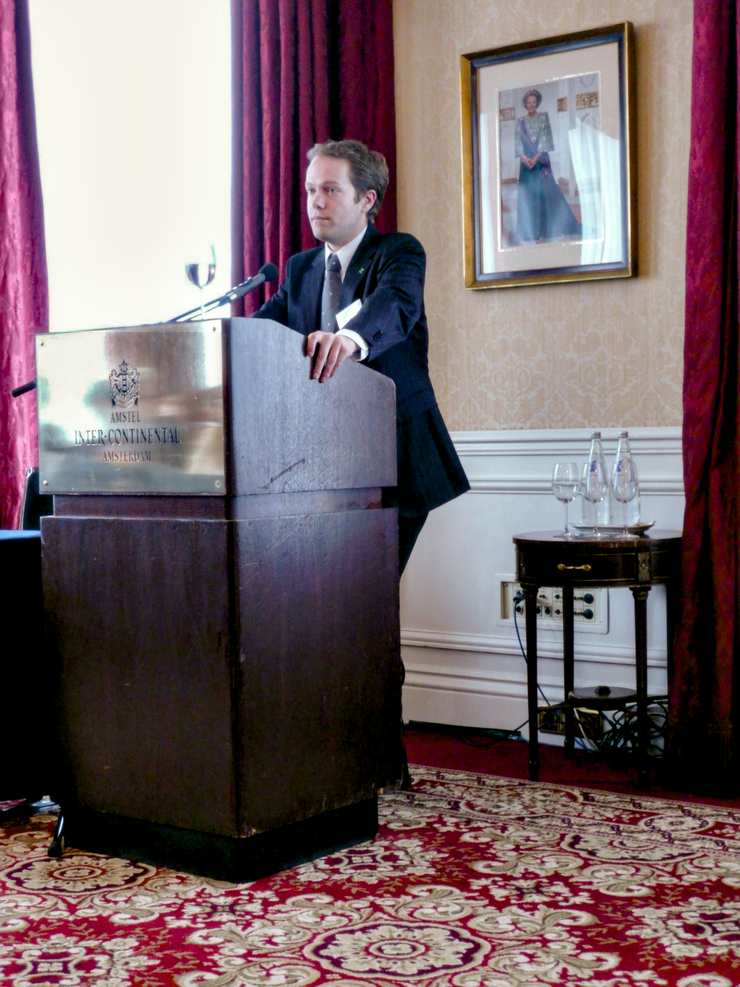
It Has Been A Long Journey…
2006, FSFE creates a legal task force with support from Harald Welte
2007, FSFE creates a network for lawyers
2008, the legal network hosts its first major legal conference
2015, OpenChain created by members of the network
2016, OpenChain launched as an LF Project

Slide 11
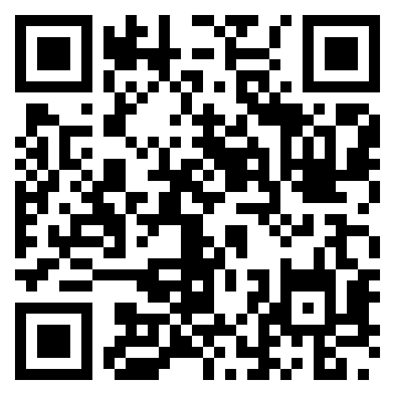
Participate In OpenChain
Our calls are open and publicly listed.
We publish a recording of every meeting not under Chatham House Rule.
We provide access to work groups, special interest groups and local work groups by mailing list.
We also use Slack and WeChat.

Slide 12
Let’s Talk More

